Slide 1
Chapter 6 – Architectural Design

Slide 2
Topics covered
Architectural design decisions
Architectural views
Architectural patterns
Application architectures

Slide 3
Architectural design
Architectural design is concerned with understanding how a software system should be organized and designing the overall structure of that system.
Architectural design is the critical link between design and requirements engineering, as it identifies the main structural components in a system and the relationships between them.
The output of the architectural design process is an architectural model that describes how the system is organized as a set of communicating components.

Slide 4
Agility and architecture
It is generally accepted that an early stage of agile processes is to design an overall systems architecture.
Refactoring the system architecture is usually expensive because it affects so many components in the system

Slide 5
The architecture of a packing robot control system
The architectural model
shows system components and the links between them.

Slide 6
Architectural abstraction
Architecture in the small is concerned with the architecture of individual programs. At this level, we are concerned with the way that an individual program is decomposed into components.
Architecture in the large is concerned with the architecture of complex enterprise systems that include other systems, programs, and program components. These enterprise systems are distributed over different computers, which may be owned and managed by different companies.

Slide 7
Importance of software architecture
Software architecture is important because it affects the performance, robustness, distributability, and maintainability of a system
Individual components implement the functional system requirements, but the dominant influence on the non-functional system characteristics is the system’s architecture.

Slide 8
Advantages of explicit architecture design
Stakeholder communication
Architecture may be used as a focus of discussion by system stakeholders.
System analysis
Making the system architecture explicit at an early stage in the system development requires some analysis
Determine whether the system can meet critical requirements
Large-scale reuse
The architecture may be reusable across a range of systems
Product-line architectures may be developed (Chapter 15).

Slide 9
Architectural representations
Simple, informal block diagrams showing entities and relationships are the most frequently used method for documenting software architectures.
But these have been criticized because they lack semantics, do not show the types of relationships between entities nor the visible properties of entities in the architecture.

Slide 10
Box and line diagrams
Very abstract - they do not show the nature of component relationships nor the externally visible properties of the sub-systems.
However, useful for communication with stakeholders and for project planning.

Slide 11
Use of architectural models
As a way of facilitating discussion about the system design
A high-level architectural view of a system is useful for communication with system stakeholders and project planning because it is not cluttered with detail. Stakeholders can relate to it and understand an abstract view of the system. They can then discuss the system as a whole without being confused by detail.
As a way of documenting an architecture that has been designed
The aim here is to produce a complete system model that shows the different components in a system, their interfaces and their connections.

Slide 12
Architectural design decisions

Slide 13
Architectural design decisions
Architectural design is a creative process so the process differs depending on the type of system being developed.
However, a number of common decisions span all design processes and these decisions affect the non-functional characteristics of the system.

Slide 14
Architectural design decisions

Slide 15
Architecture reuse
Systems in the same domain often have similar architectures that reflect domain concepts.
Application product lines are built around a core architecture with variants that satisfy particular customer requirements.
The architecture of a system may be designed around one of more architectural patterns or ‘styles’.
These capture the essence of an architecture and can be instantiated in different ways.

Slide 16
Architecture and non-functional requirements
If Performance is a critical requirement
Localize critical operations and minimize communications. Use large rather than fine-grain components.
If Security is a critical requirement
Use a layered architecture with critical assets in the inner layers.
Minimize the number of copies of the data and, wherever possible.
Each component only knows as much as it needs to, to do its job (least privilege).
If Safety is a critical requirement
Localize safety-critical features in a small number of sub-systems.

Slide 17
Architecture and non-functional requirements
If Availability is a critical requirement
Include redundant components and mechanisms for fault tolerance.
If Maintainability is a critical requirement
Use fine-grain, replaceable components
Producers of data should be separated from consumers
Shared data structures should be avoided

Slide 18
Potential conflict
Performance vs. Maintainability
Why there might be an architectural conflict between performance and maintainability when both are the most important non-functional requirements?
How to solve the conflict?
Security vs. Availability
Why there might be an architectural conflict between security and availability when both are the most important non-functional requirements?
How to solve the conflict?

Slide 19
Architectural design evaluation
Evaluating an architectural design is difficult because the true test of an architecture is how well the system meets its functional and non-functional requirements when it is in use.
However, you can do some evaluation by comparing your design against reference architectures or generic Architectural patterns.

Slide 20
Architectural views

Slide 21
Use of architectural models
As a way of facilitating discussion about the system design
A high-level architectural view of a system is useful for communication with system stakeholders and project planning because it is not cluttered with detail. Stakeholders can relate to it and understand an abstract view of the system. They can then discuss the system as a whole without being confused by detail.
As a way of documenting an architecture that has been designed
The aim here is to produce a complete system model that shows the different components in a system, their interfaces and their connections.

Slide 22
Architectural views
What views or perspectives are useful when designing and documenting a system’s architecture?
What notations should be used for describing architectural models?
Each architectural model only shows one view or perspective of the system.
It might show how a system is decomposed into modules, how the run-time processes interact or the different ways in which system components are distributed across a network. For both design and documentation, you usually need to present multiple views of the software architecture.

Slide 23
Architectural views
4+1 view model by Krutchen (Krutchen 1995)

Slide 24
4 + 1 view model of software architecture
A logical view, which shows the key abstractions in the system as objects or object classes.
A process view, which shows how, at run-time, the system is composed of interacting processes.
A development view, which shows how the software is decomposed for development.
A physical view, which shows the system hardware and how software components are distributed across the processors in the system.
Related using use cases or scenarios (+1)

Slide 25
Representing architectural views
Some people argue that the Unified Modeling Language (UML) is an appropriate notation for describing and documenting system architectures
I disagree with this as I do not think that the UML includes abstractions appropriate for high-level system description.
Architectural description languages (ADLs) have been developed but are not widely used

Slide 26
Representing architectural views
Users of agile methods claim that detailed design documentation is mostly unused. It is, therefore, a waste of time and money to develop these documents
You should develop the views that are useful for communication and not worry about whether or not your architectural documentation is complete

Slide 27
Architectural patterns

Slide 28
Architectural patterns
Patterns are a means of representing, sharing and reusing knowledge.
An architectural pattern is a stylized description of good design practice, which has been tried and tested in different environments.
Patterns should include information about when they are and when the are not useful.
Patterns may be represented using tabular and graphical descriptions.

Slide 29

Without architectural patterns

Slide 30

Architectural patterns

Slide 31
The Model-View-Controller (MVC) pattern
Name | MVC (Model-View-Controller)
Description | Separates presentation and interaction from the system data. The system is structured into three logical components that interact with each other. The Model component manages the system data and associated operations on that data. The View component defines and manages how the data is presented to the user. The Controller component manages user interaction (e.g., key presses, mouse clicks, etc.) and passes these interactions to the View and the Model. See Figure 6.3.
Example | Figure 6.4 shows the architecture of a web-based application system organized using the MVC pattern.
When used | Used when there are multiple ways to view and interact with data. Also used when the future requirements for interaction and presentation of data are unknown.
Advantages | Allows the data to change independently of its representation and vice versa. Supports presentation of the same data in different ways with changes made in one representation shown in all of them.
Disadvantages | Can involve additional code and code complexity when the data model and interactions are simple.

Slide 32
The organization of the Model-View-Controller

Slide 33
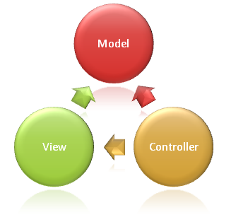
The organization of the Model-View-Controller

Slide 34
Web application architecture using the MVC pattern

Slide 35
Responsibilities of MVC components in Web application
Model Responsibilities
The Model in an MVC application represents the state of the application and any business logic or operations that should be performed by it
View Responsibilities
Presents content through the user interface
Should contain minimal logic and any logic should relate to presenting content (use ViewModel if complex logic is needed to present the content)

Slide 36
Responsibilities of MVC components in Web application
Controller Responsibilities
Handles user interaction
Responds to user input and interaction
Is the initial entry point
Is responsible for selecting which model types to work with and which view to render

Slide 37
Advantages of using MVC pattern
It helps to achieve separation of concerns
It is easier to debug and test an application that is using MVC pattern
Allows the data to change independently of its representation and vice versa.
Supports presentation of the same data in different ways with changes made in one representation shown in all of them.

Slide 38
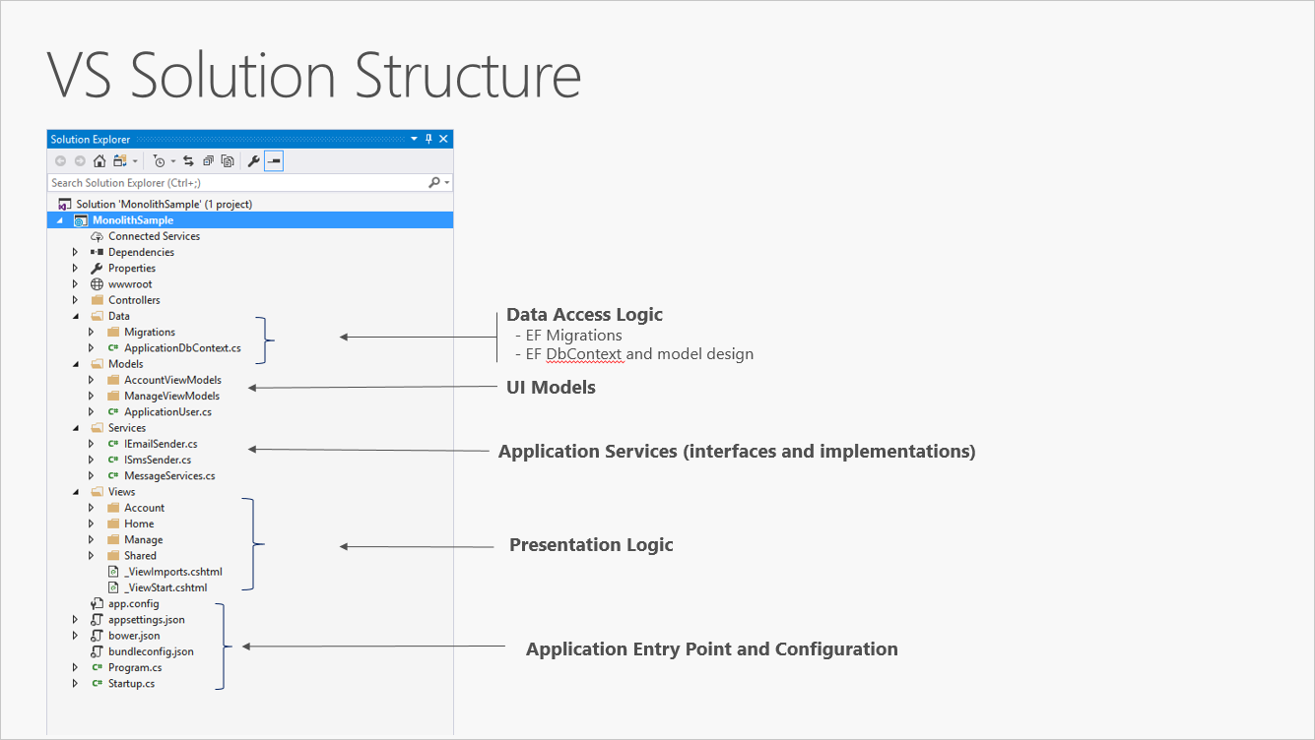
MVC Web application example: All-in-one

Slide 39
MVC Web application example: All-in-one
Separation of concerns is achieved through the use of folders (Models, Views, Controllers, Data, and Services)
As the project's size and complexity grows, the number of files and folders will continue to grow as well
Business logic is scattered between the Models and Services folders, and there’s no clear indication of which classes in which folders should depend on which others
The lack of organization at the project level frequently leads to spaghetti code

Slide 40
Layered architecture
To address the issues in the all-in-one architecture
Used to model the interfacing of sub-systems.
Organizes the system into a set of layers (or abstract machines) each of which provide a set of services.
Supports the incremental development of sub-systems in different layers. When a layer interface changes, only the adjacent layer is affected.

Slide 41
The Layered architecture pattern
Name | Layered architecture
Description | Organizes the system into layers with related functionality associated with each layer. A layer provides services to the layer above it so the lowest-level layers represent core services that are likely to be used throughout the system. See Figure 6.6.
Example | A layered model of a system for sharing copyright documents held in different libraries, as shown in Figure 6.7.
When used | Used when building new facilities on top of existing systems; when the development is spread across several teams with each team responsibility for a layer of functionality; when there is a requirement for multi-level security.
Advantages | Allows replacement of entire layers so long as the interface is maintained. Redundant facilities (e.g., authentication) can be provided in each layer to increase the dependability of the system.
Disadvantages | In practice, providing a clean separation between layers is often difficult and a high-level layer may have to interact directly with lower-level layers rather than through the layer immediately below it. Performance can be a problem because of multiple levels of interpretation of a service request as it is processed at each layer.

Slide 42
A generic layered architecture

Slide 43
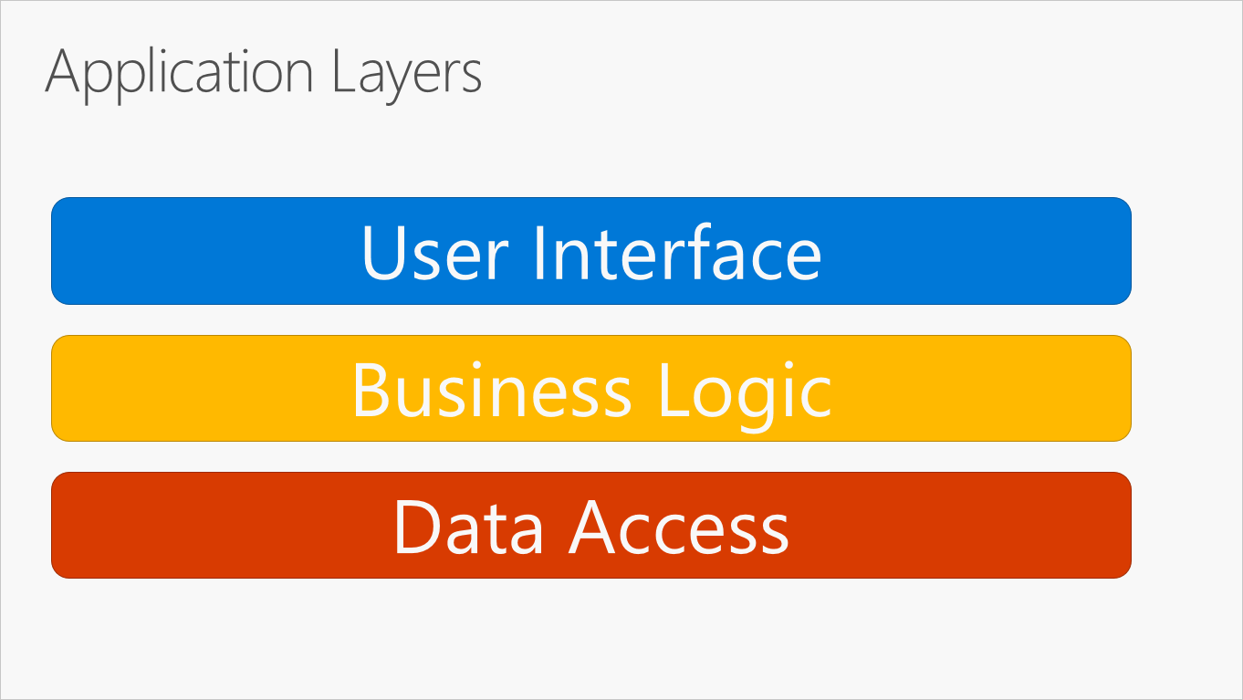
Traditional “N-Layer” architecture

Slide 44
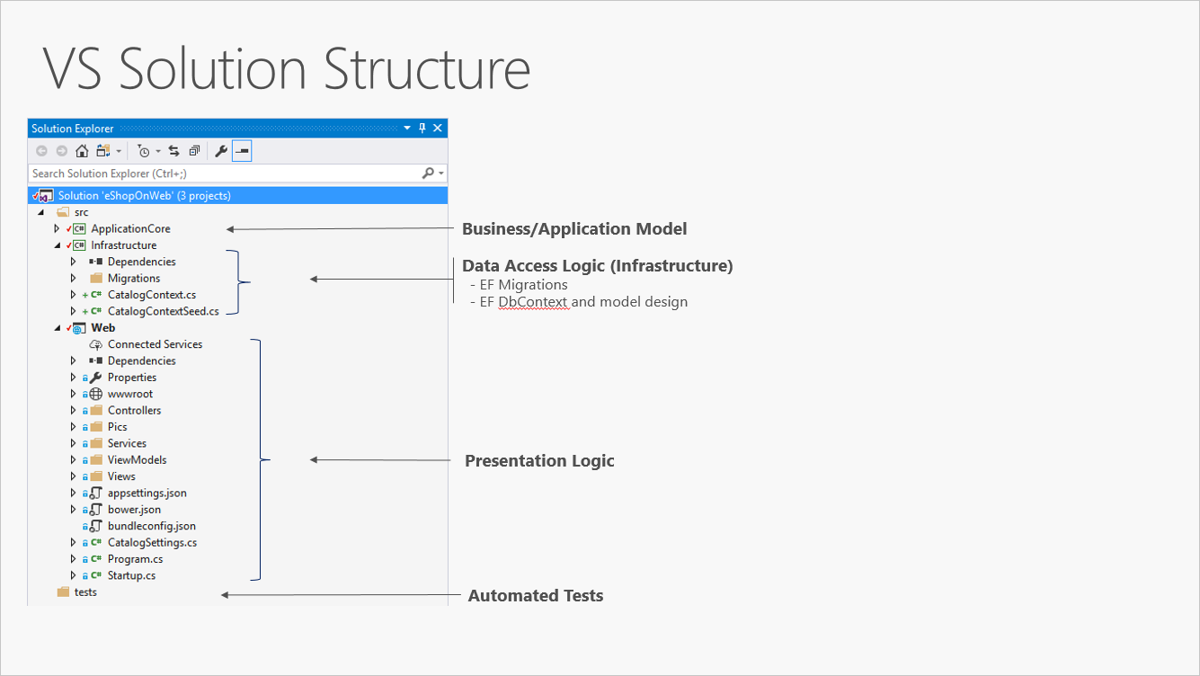
Example of “N-Layer” architecture

Slide 45
Advantages of the layered architecture pattern
By organizing code into layers, common low-level functionality can be reused throughout the application (DRY principle)
With a layered architecture, applications can enforce restrictions on which layers can communicate with other layers. This helps to achieve encapsulation
Layers and encapsulation make it much easier to replace functionality within the application
Layers can also make it easier to swap out implementations for testing purpose

Slide 46
Disadvantage of traditional layered architecture
Dependencies run from the top layer to the bottom layer, which makes it difficult to test each layer

Slide 47
The architecture of the iLearn system

Slide 48
Clean architecture (Onion architecture)
Applications that follow the Dependency Inversion Principle as well as the Domain-Driven Design (DDD) principles are usually called applications with Clean Architecture
Clean Architecture puts the business logic and application model at the center of the application.
Instead of having business logic depend on data access or other infrastructure concerns, this dependency is inverted: infrastructure and implementation details depend on the Application Core.

Slide 49
Clean architecture (Onion architecture)
This is achieved by defining abstractions, or interfaces, in the Application Core, which are then implemented by types defined in the Infrastructure layer.
Dependencies flow toward the innermost circle
Application Core has no dependencies on other application layers

Slide 50
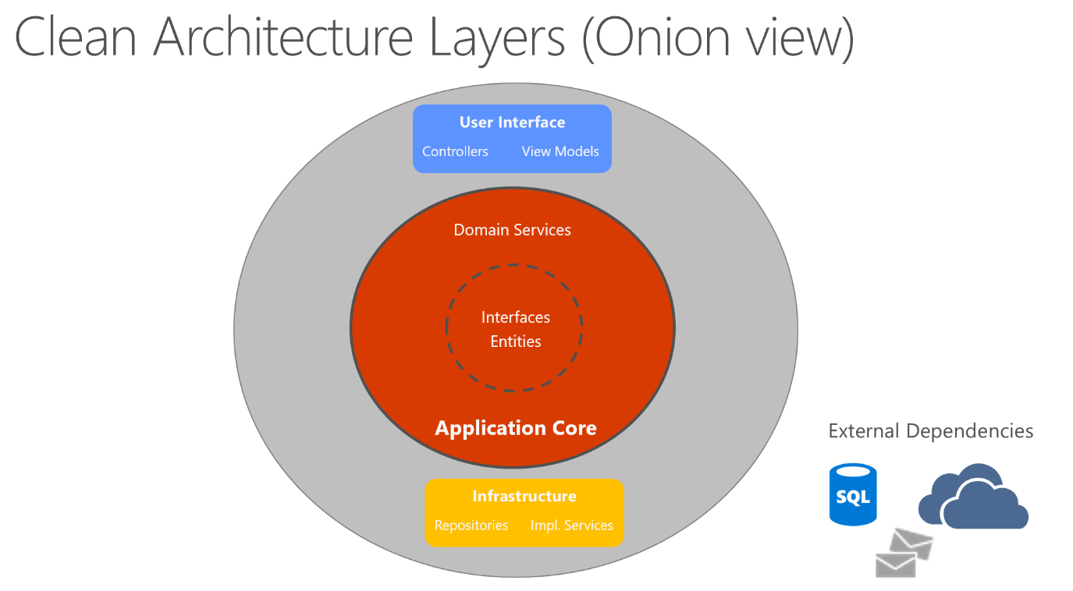
Clean Architecture

Slide 51
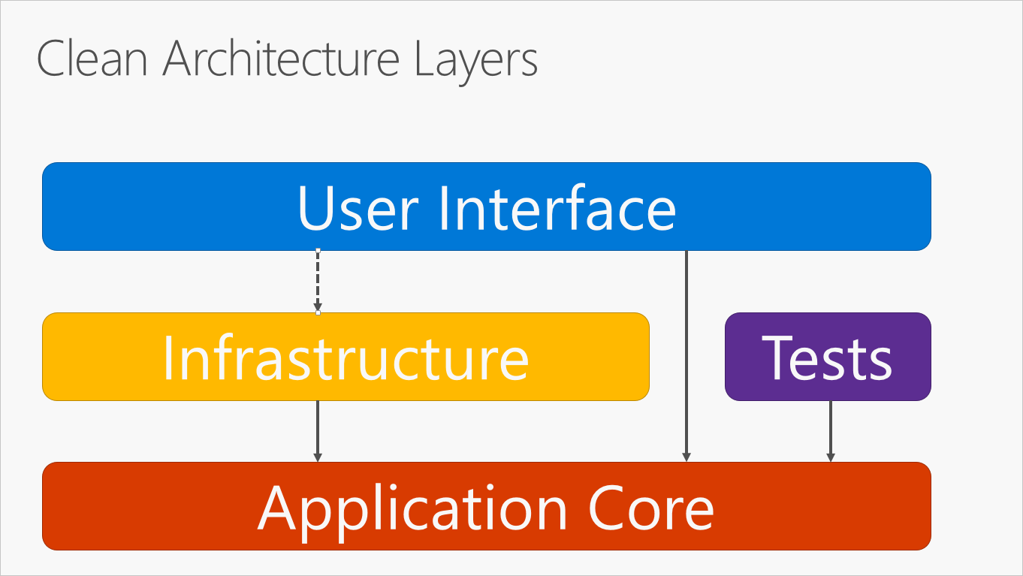
Clean Architecture

Slide 52
Repository architecture
Sub-systems must exchange data. This may be done in two ways:
Shared data is held in a central database or repository and may be accessed by all sub-systems;
Each sub-system maintains its own database and passes data explicitly to other sub-systems.
When large amounts of data are to be shared, the repository model of sharing is most commonly used a this is an efficient data sharing mechanism.

Slide 53
The Repository pattern
Name | Repository
Description | All data in a system is managed in a central repository that is accessible to all system components. Components do not interact directly, only through the repository.
Example | Figure 6.9 is an example of an IDE where the components use a repository of system design information. Each software tool generates information which is then available for use by other tools.
When used | You should use this pattern when you have a system in which large volumes of information are generated that has to be stored for a long time. You may also use it in data-driven systems where the inclusion of data in the repository triggers an action or tool.
Advantages | Components can be independent—they do not need to know of the existence of other components. Changes made by one component can be propagated to all components. All data can be managed consistently (e.g., backups done at the same time) as it is all in one place.
Disadvantages | The repository is a single point of failure so problems in the repository affect the whole system. May be inefficient in organizing all communication through the repository. Distributing the repository across several computers may be difficult.

Slide 54
A repository architecture for an IDE

Slide 55
Examples of repository architecture
Command and control system
Management information system
Computer-Aided Design (CAD) system
Version-Control system

Slide 56
Client-server architecture
Distributed system model which shows how data and processing is distributed across a range of components.
Can be implemented on a single computer.
Set of stand-alone servers which provide specific services such as printing, data management, etc.
Set of clients which call on these services.
Network which allows clients to access servers.

Slide 57
The Client–server pattern
Name | Client-server
Description | In a client–server architecture, the functionality of the system is organized into services, with each service delivered from a separate server. Clients are users of these services and access servers to make use of them.
Example | Figure 6.11 is an example of a film and video/DVD library organized as a client–server system.
When used | Used when data in a shared database has to be accessed from a range of locations. Because servers can be replicated, may also be used when the load on a system is variable.
Advantages | The principal advantage of this model is that servers can be distributed across a network. General functionality (e.g., a printing service) can be available to all clients and does not need to be implemented by all services.
Disadvantages | Each service is a single point of failure so susceptible to denial of service attacks or server failure. Performance may be unpredictable because it depends on the network as well as the system. May be management problems if servers are owned by different organizations.

Slide 58
Major components of the client–server pattern
A set of servers that offer services to other components. Servers are software components, and several servers may run on the same computer.
A set of clients that call on the services offered by servers.
A network that allows the clients to access these services. Client–server systems are usually implemented as distributed systems, connected using Internet protocols.

Slide 59
The client–server pattern
Client–server architectures are usually thought of as distributed systems architectures, but the logical model of independent services running on separate servers can be implemented on a single computer.
Clients may have to know the names of the available servers and the services they provide. However, servers don’t need to know the identity of clients or how many clients are accessing their services.
Clients access the services provided by a server through remote procedure calls using a request-reply protocol (such as HTTP).

Slide 60

A client–server architecture

Slide 61
A client–server architecture for a film library

Slide 62
Advantages of the client–server pattern
The most important advantage of the client-server model is that it is a distributed architecture in which servers can be distributed across a network.
It is easy to add a new server and integrate it with the rest of the system or to upgrade servers transparently without affecting other parts of the system.

Slide 63
Disadvantages of the client–server pattern
Each service is a single point of failure and so is susceptible to denial-of-service attacks or server failure.
Performance is dependent on the network as well as the system

Slide 64
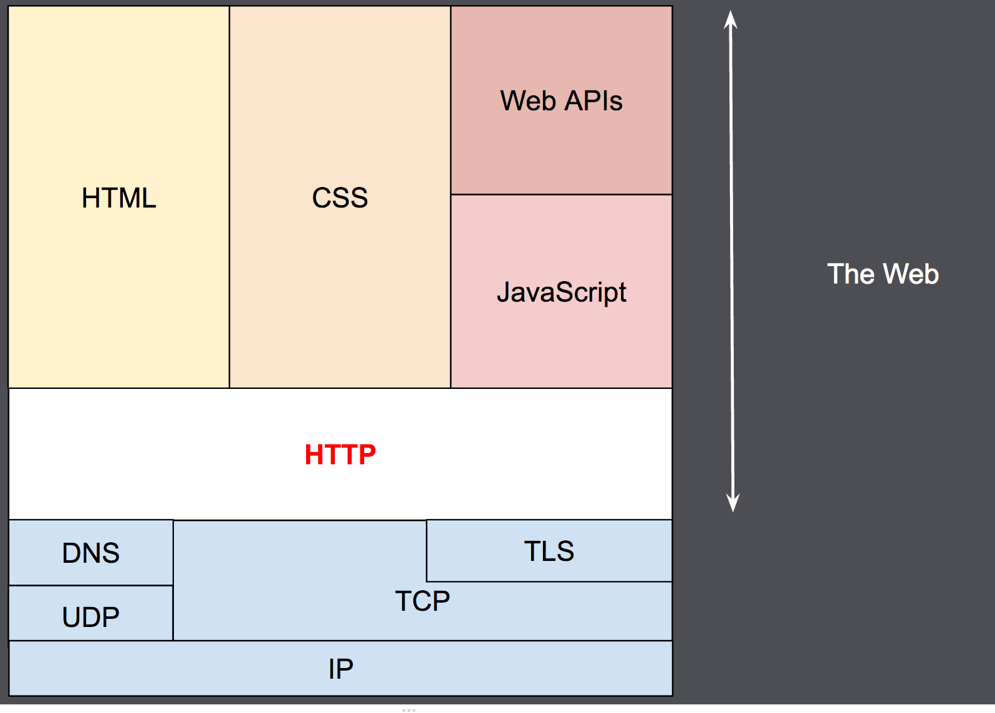
Overview of HTTP
HTTP is a protocol which allows the fetching of resources, such as HTML documents. It is the foundation of any data exchange on the Web and it is a client-server protocol

Slide 65
Basic aspects of HTTP
HTTP is simple. HTTP messages can be read and understood by humans
HTTP is extensible. HTTP headers make this protocol easy to extend and experiment with
HTTP is stateless. There is no link between two requests being successively carried out on the same connection

Slide 66
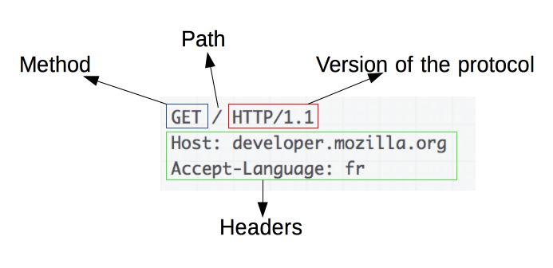
HTTP messages
Human-readable messages exchanged between client and server
Two types: Requests and Responses
Requests

Slide 67
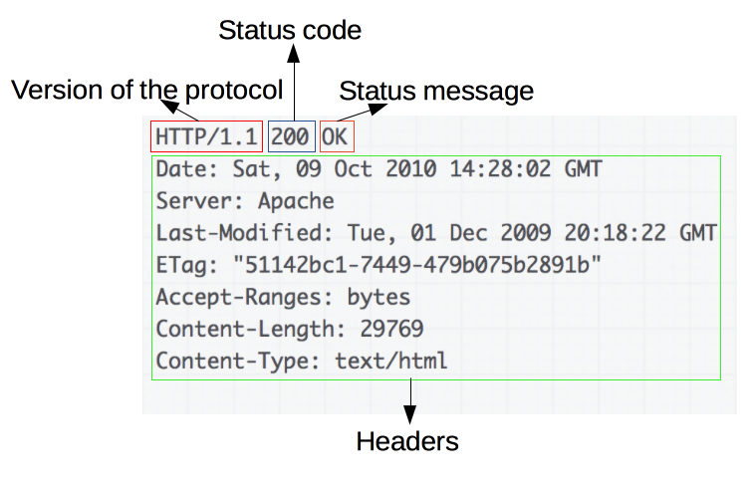
HTTP messages
Responses

Slide 68
HTTP status codes
200 OK
201 Created
400 Bad Request
401 Unauthorized
403 Forbidden
404 Not Found
500 Internal Server Error
503 Service Unavailable

Slide 69
Denial-of-service attack
A denial-of-service attack (DoS attack) is a cyber-attack in which the perpetrator seeks to make a machine or network resource unavailable to its intended users by temporarily or indefinitely disrupting services of a host connected to the Internet.
Denial of service is typically accomplished by flooding the targeted machine or resource with superfluous requests in an attempt to overload systems and prevent some or all legitimate requests from being fulfilled.

Slide 70
DoS attack techniques
SYN flood
HTTP POST DoS attack
TTL expiry attack

Slide 71
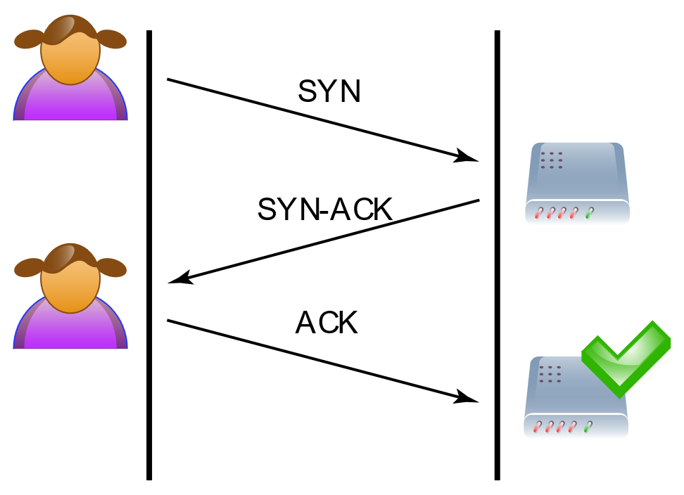
DoS attack techniques
SYN flood
TCP three-way handshake
The client requests a connection by sending a SYN (synchronize) message to the server
The server acknowledges this request by sending a SYN-ACK back to the client
The client responds with an ACK, and the connection is established

Slide 72
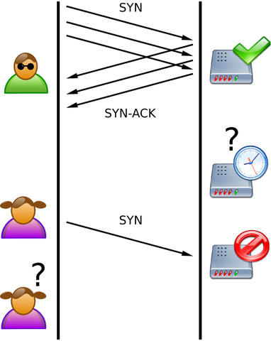
DoS attack techniques
SYN flood
Does not respond to the server with the expected ACK code
Simply not send the ACK code
Spoof the source IP addresses in the SYN

Slide 73
Pipe and filter architecture
Functional transformations process their inputs to produce outputs.
May be referred to as a pipe and filter model (as in UNIX shell).
Variants of this approach are very common. When transformations are sequential, this is a batch sequential model which is extensively used in data processing systems.
Not really suitable for interactive systems.

Slide 74
The pipe and filter pattern
Name | Pipe and filter
Description | The processing of the data in a system is organized so that each processing component (filter) is discrete and carries out one type of data transformation. The data flows (as in a pipe) from one component to another for processing.
Example | Figure 6.13 is an example of a pipe and filter system used for processing invoices.
When used | Commonly used in data processing applications (both batch- and transaction-based) where inputs are processed in separate stages to generate related outputs.
Advantages | Easy to understand and supports transformation reuse. Workflow style matches the structure of many business processes. Evolution by adding transformations is straightforward. Can be implemented as either a sequential or concurrent system.
Disadvantages | The format for data transfer has to be agreed upon between communicating transformations. Each transformation must parse its input and unparse its output to the agreed form. This increases system overhead and may mean that it is impossible to reuse functional transformations that use incompatible data structures.

Slide 75
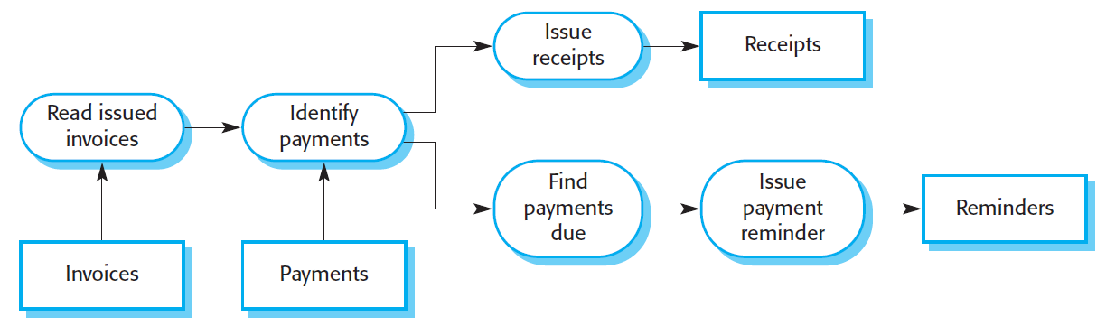
An example of the pipe and filter architecture used in a payments system

Slide 76
Application architectures

Slide 77
Application architectures
Application systems are designed to meet an organizational need.
As businesses have much in common, their application systems also tend to have a common architecture that reflects the application requirements.
A generic application architecture is an architecture for a type of software system that may be configured and adapted to create a system that meets specific requirements.

Slide 78
Use of application architectures
As a starting point for architectural design.
As a design checklist.
As a way of organising the work of the development team.
As a means of assessing components for reuse.
As a vocabulary for talking about application types.

Slide 79
Examples of application types
Data processing applications
Data driven applications that process data in batches without explicit user intervention during the processing.
Transaction processing applications
Data-centred applications that process user requests and update information in a system database.
Event processing systems
Applications where system actions depend on interpreting events from the system’s environment.
Language processing systems
Applications where the users’ intentions are specified in a formal language that is processed and interpreted by the system.

Slide 80
Application type examples
Two very widely used generic application architectures are transaction processing systems and language processing systems.
Transaction processing systems
E-commerce systems;
Reservation systems.
Language processing systems
Compilers;
Command interpreters.

Slide 81
Transaction processing systems
Process user requests for information from a database or requests to update the database.
From a user perspective a transaction is:
Any coherent sequence of operations that satisfies a goal;
For example - find the times of flights from London to Paris.
Users make asynchronous requests for service which are then processed by a transaction manager.

Slide 82
The structure of transaction processing applications

Slide 83
The software architecture of an ATM system

Slide 84
Information systems architecture
Information systems have a generic architecture that can be organized as a layered architecture.
These are transaction-based systems as interaction with these systems generally involves database transactions.
Layers include:
The user interface
User communications
Information retrieval
System database

Slide 85
Layered information system architecture

Slide 86
The architecture of the Mentcare system

Slide 87
Web-based information systems
Information and resource management systems are now usually web-based systems where the user interfaces are implemented using a web browser.
For example, e-commerce systems are Internet-based resource management systems that accept electronic orders for goods or services and then arrange delivery of these goods or services to the customer.
In an e-commerce system, the application-specific layer includes additional functionality supporting a ‘shopping cart’ in which users can place a number of items in separate transactions, then pay for them all together in a single transaction.

Slide 88
Server implementation
These systems are often implemented as multi-tier client server/architectures (discussed in Chapter 17)
The web server is responsible for all user communications, with the user interface implemented using a web browser;
The application server is responsible for implementing application-specific logic as well as information storage and retrieval requests;
The database server moves information to and from the database and handles transaction management.

Slide 89
Language processing systems
Accept a natural or artificial language as input and generate some other representation of that language.
May include an interpreter to act on the instructions in the language that is being processed.
Used in situations where the easiest way to solve a problem is to describe an algorithm or describe the system data
Meta-case tools process tool descriptions, method rules, etc and generate tools.

Slide 90
The architecture of a language processing system

Slide 91
Compiler components
A lexical analyzer, which takes input language tokens and converts them to an internal form.
A symbol table, which holds information about the names of entities (variables, class names, object names, etc.) used in the text that is being translated.
A syntax analyzer, which checks the syntax of the language being translated.
A syntax tree, which is an internal structure representing the program being compiled.

Slide 92
Compiler components
A semantic analyzer that uses information from the syntax tree and the symbol table to check the semantic correctness of the input language text.
A code generator that ‘walks’ the syntax tree and generates abstract machine code.

Slide 93
A repository architecture for a language processing system

Slide 94
A pipe and filter compiler architecture

Slide 95
Key points
A software architecture is a description of how a software system is organized.
Architectural design decisions include decisions on the type of application, the distribution of the system, the architectural styles to be used.
Architectures may be documented from several different perspectives or views such as a conceptual view, a logical view, a process view, and a development view.
Architectural patterns are a means of reusing knowledge about generic system architectures. They describe the architecture, explain when it may be used and describe its advantages and disadvantages.

Slide 96
Key points
Models of application systems architectures help us understand and compare applications, validate application system designs and assess large-scale components for reuse.
Transaction processing systems are interactive systems that allow information in a database to be remotely accessed and modified by a number of users.
Language processing systems are used to translate texts from one language into another and to carry out the instructions specified in the input language. They include a translator and an abstract machine that executes the generated language.

